Slide 1
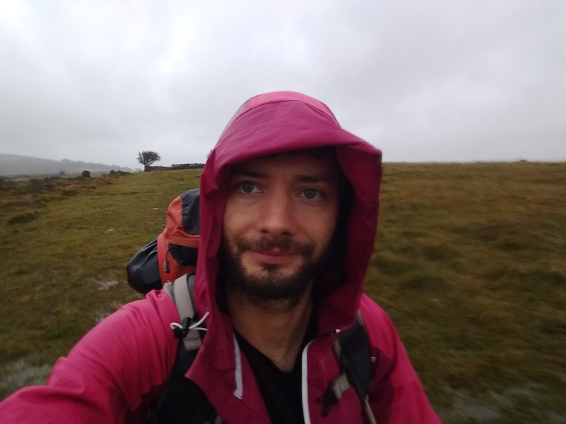
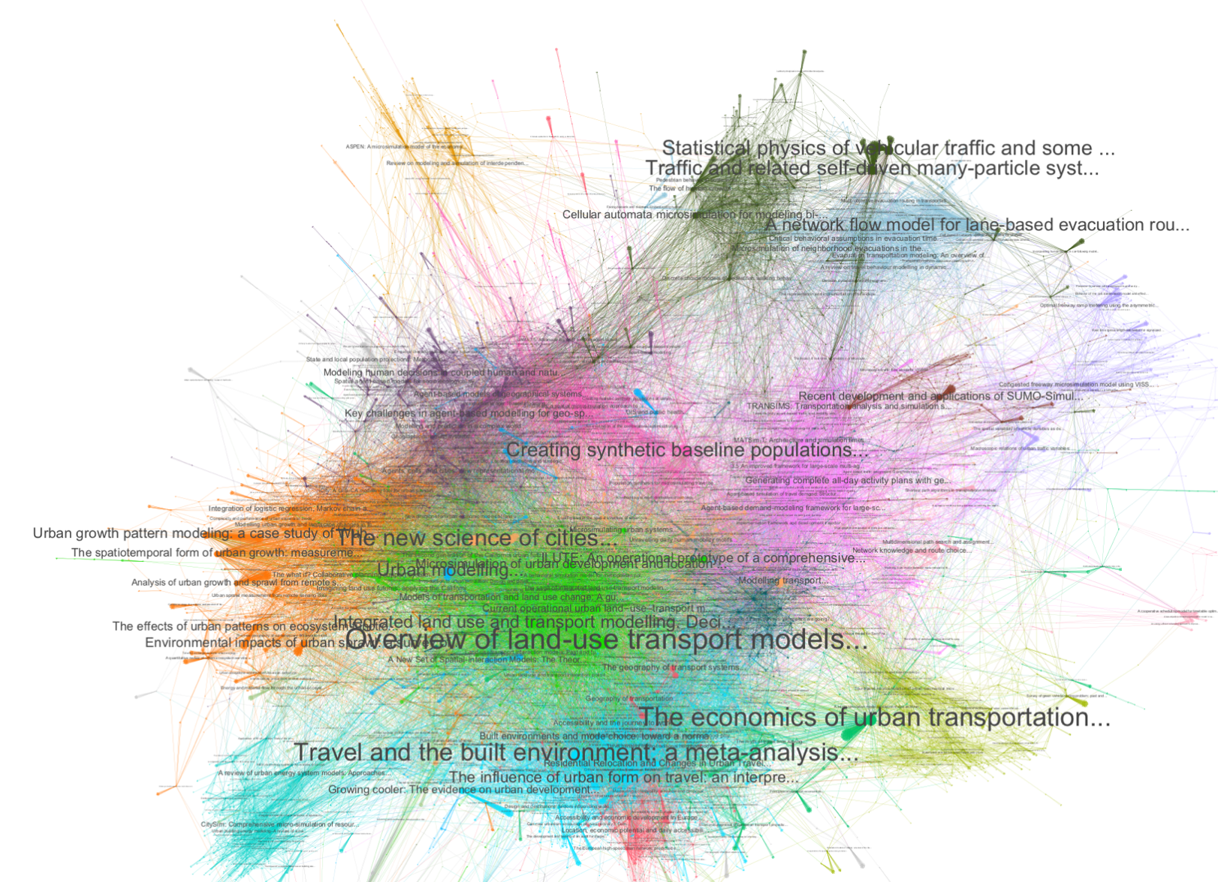
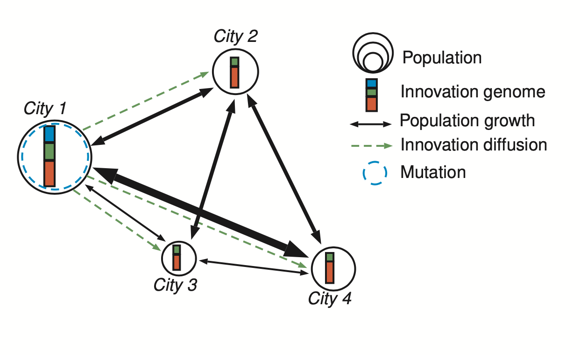
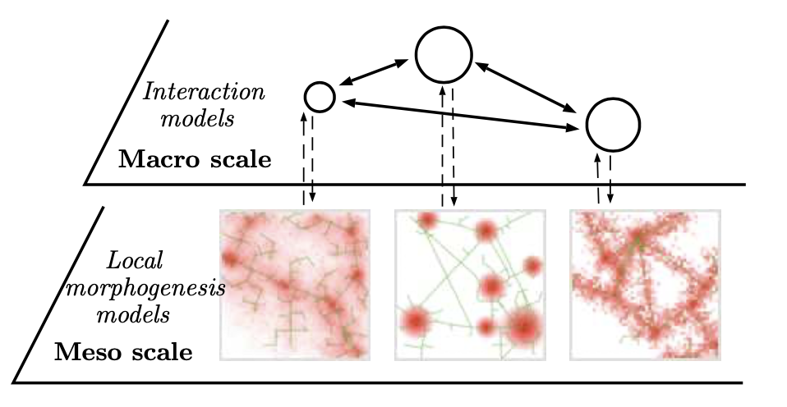
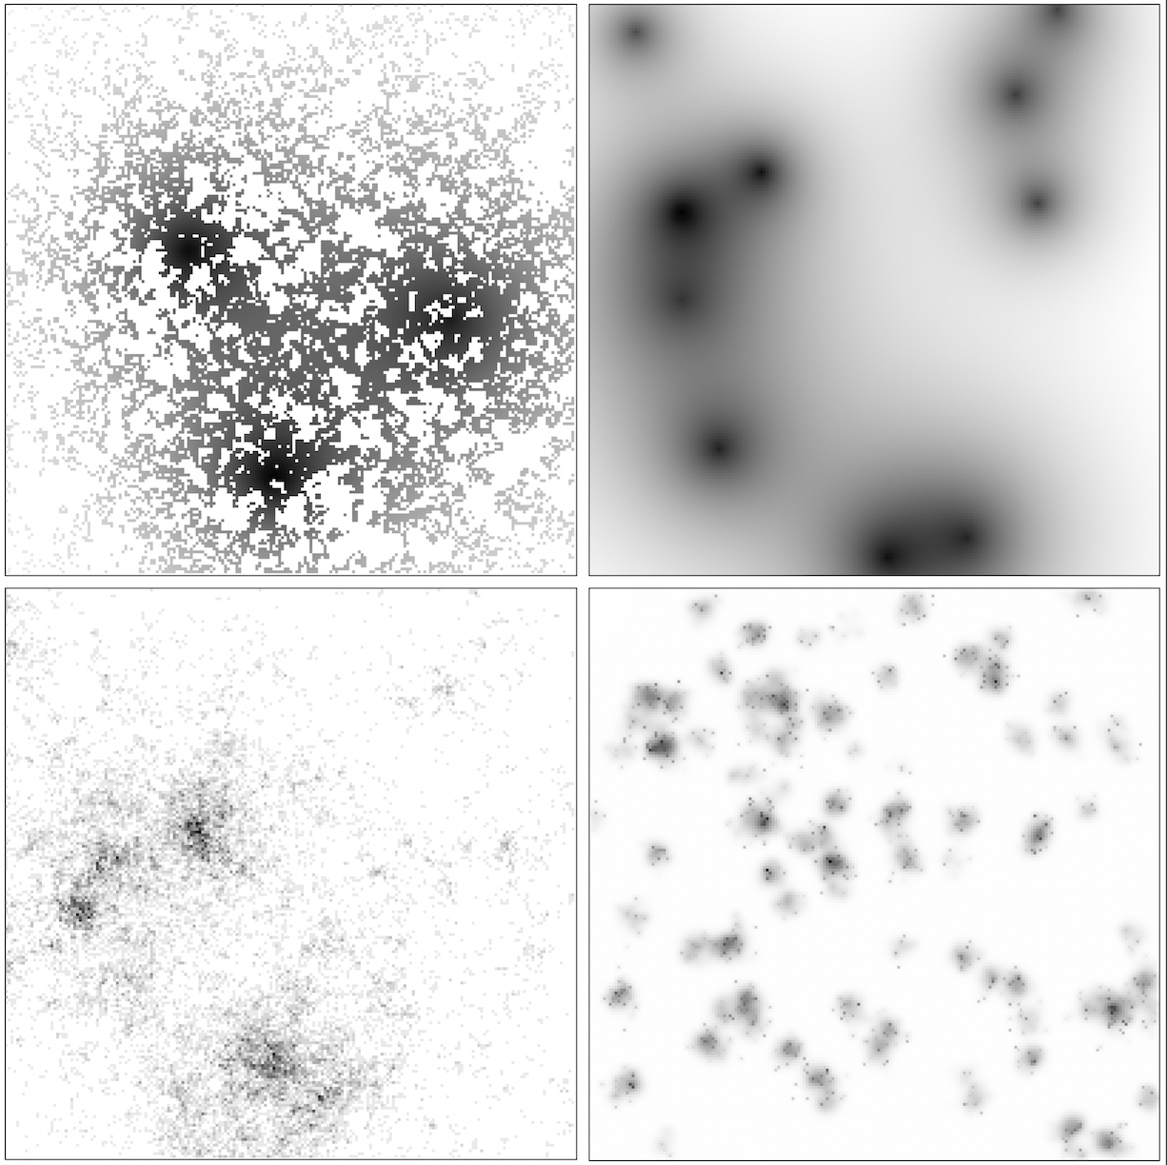
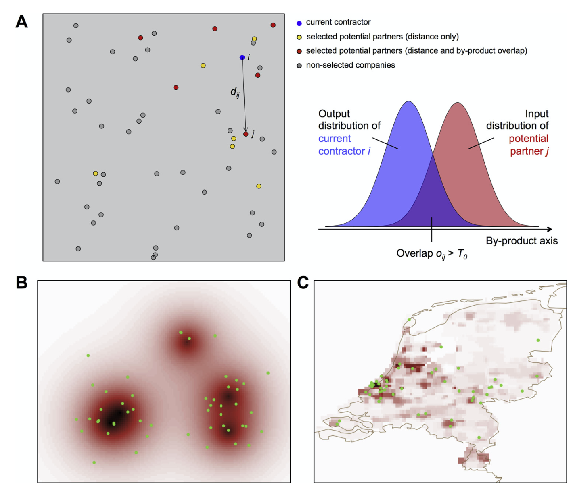
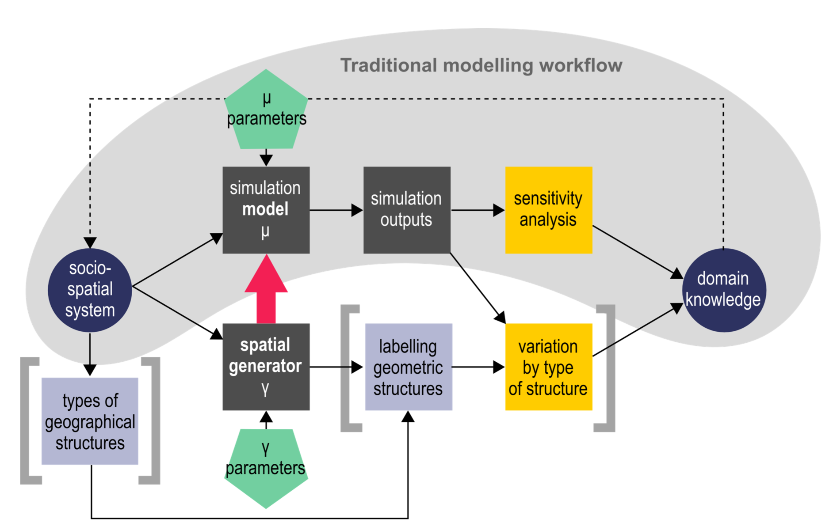



Juste Raimbault (j.raimbault@ucl.ac.uk) Research Fellow – Urban Dynamics Lab
Quantitative epistemology
Urban modeling
Evolutionary approach to systems of cities
Land-use transport interactions / microsimulation
Towards integrated multi-scalar urban theories and models
QUANT
SPENSER
MATSim
Citation and semantic networks, patents and innovation
Methodology
Model validation
Spatial sensitivity analysis
High performance computing
Urban morphogenesis
ABMs for sustainability

